Slide 1

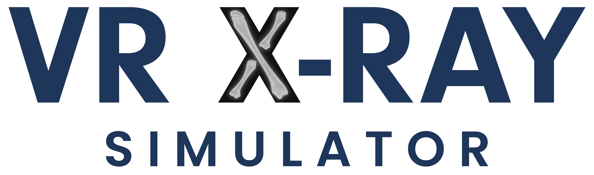
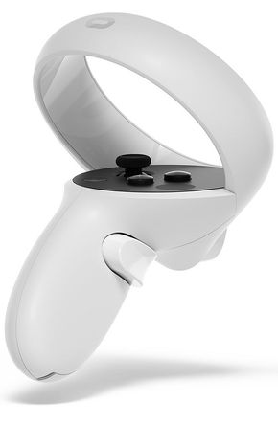
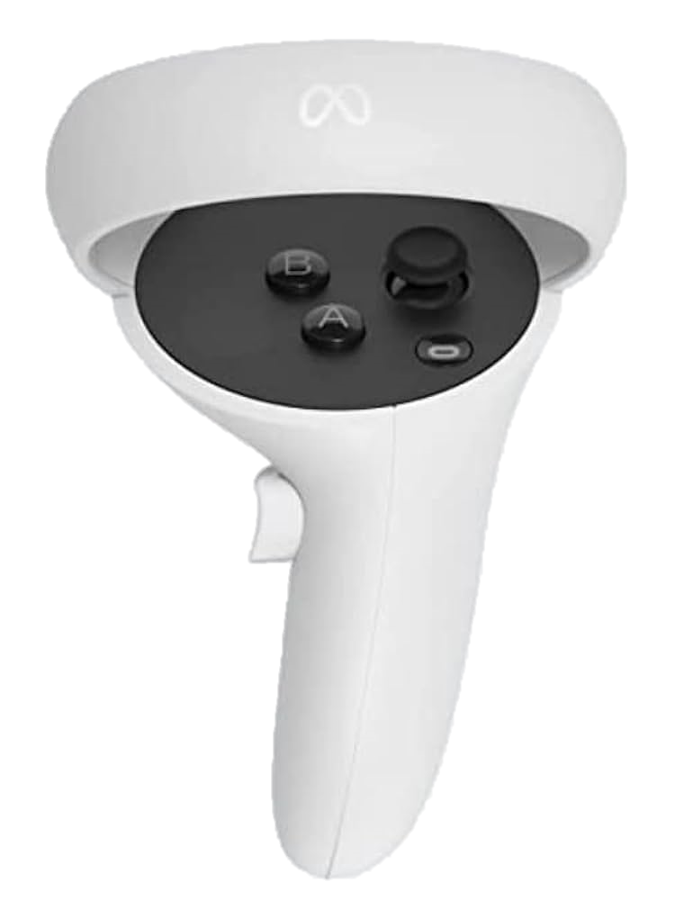
Controller Guide
1 - Grab
To pick up and manipulate objects in your VR world, utilize the button on the side of each controller, reachable with your long middle finger. This button allows you to grab items, and you can use both controllers simultaneously.
2
2 - Move and rotate
The little thumbpad on top of each controller is your key to movement. Use your thumb to interact with the thumbstick on both the left and right controllers. Moving the thumbstick forward, coupled with pointing the controller at the floor, reveals a blue circle. Release the thumbstick to teleport to the circle's location. Additionally, pressing the thumbstick left or right facilitates a 45-degree snap rotation.
3
1
5
4
L
3 - Access Main Menu
Access the main menu by pressing the A or X button on top of the controller. Within this menu, you can seamlessly switch between cases and exit the application
2
3
4 - Click
Utilize the trigger button on the front of the controller with your index finger to interact with the main menu.
1
5 - X-ray Imaging
To perform an X-ray image, grab the X-ray button from the table and press and hold the Click(4) button located on the front of the controllers.
R

